Slide 1
Project Presentation
CS613
Alzheimer's Classification using OASIS Dataset
Subhrato Som
Imon Bera

Slide 2
Overview
Problem
Data Source
Related Works
Method
Models
Experiments
Conclusion
Future Work
References

Slide 3
Problem
We classified various phases of Alzheimer’s Disease.
Alzheimer’s is a neurodegenerative disorder
Loss of memory & reasoning
eventually Dementia
Need of capable Machine Learning models for Alzheimer’s
Identify trends in pre-disease symptoms
Drug development
Quality of Life

Slide 4
Data Source
OASIS Alzheimer's Detection Dataset, a take on Marcus et. at OASIS-1.
Source: https://www.kaggle.com/datasets/ninadaithal/imagesoasis
80,000 (498x258) brain MRI images of 461 patients, classified into four labels based on the provided metadata and Clinical Dementia Rating (CDR) values on Alzheimer's progression.
Dataset Size: 1.3 GB

Slide 5
Data Preprocessing
Due to class imbalance, we had to reduced our data set as follows:
For binary classification: 488 images from the non-demented class labeled not Alzheimer's, and from all other 3 classes we took 162 images from each and labeled as Alzheimer's. Class Prior: 50%.
In multiclass moderate dementia class had 488 images, so we randomly sampled 488 images from each class. Class Prior: 25%.
Downsampled it and worked with two feature dimensions of images one being 1/8 of the size of the image which is (64x32) and the other being 1/4 which is (128x64).
Modified the image to get blurred images and separately applied canny edge detection to get the edges.

Slide 6
Related Works
Challis et al.:
Used Bayesian Gaussian Linear Regression for brain analysis.
achieved 75% accuracy in distinguishing mild dementia from normal brains.
97% accuracy in mild dementia from Alzheimer's.
Subramoniam et al:
Used Resnet 101 for feature extraction.
Labels (non-demented, mild, very mild, and moderate).
Achieved accuracy of 95.32% using CNN along with a dense layered Deep Neural Network (DNN).
Knox et al.:
Used separately trained Auto-Encoders for feature extraction on a localized hippocampal MRI dataset.
Gaussian Naive Bayes for classification.
Accuracy of around 80% in classifying extracted features of brain images.

Slide 7
Related Works (cont'd)
Fulton et al.:
Proposed using Resnet-50 for detecting Clinical Dementia.
Employed Gradient Boosting for Alzheimer's analysis, achieving 91% accuracy on a minimal mental state exam data.
Achieved a remarkable 99% accuracy in 3-class classifications of Dementia using Resnet-50.
Durate et al.:
Transfer Learning techniques with VGG16 on a small dataset.
Applied SVM and other approaches.
Conducted binary classification for Alzheimer's detection.
FP Priori performed best with 71%.

Slide 8
Models (2 Dimensions: 128x64 & 64x32)
Binary Classification ( Alzheimer’s-Not Alzheimer’s)
Logistic Regression
LDA
PCA ( Time Complexity )
Multiclass Classification(Non Demented, Very Mild, Mild, Moderate)
MultiLDA (PCA ( Time Complexity ))
Normal
Blur
Canny Edge
K Nearest Neighbours
Normal
Blur
Canny Edge

Slide 9
Models (cont’d)
Multiclass Classification
Naive Bayes
Normal
Blur
Canny Edge
1 vs 1 Approaches
1vs1 Logistic Regression
Normal
Blur
Canny Edge
1vs1 LDA
Normal
Blur
Canny Edge

Slide 10
Models (cont’d)
Ensemble (Mean Ensemble)
KNN (Canny Edge)
1 vs 1 LDA (Normal)
1 vs 1 Logistic Regression (Normal)

Slide 11
Experiments and Results
Binary Classification
BINARY | LDA(PCA)
 | 64x32 | 128x64
 | 0.7046153846 | 0.7784615385
 | Log Regression
 | 64x32 | 128x64
 | 0.7292307692 | 0.7507692308

Slide 12
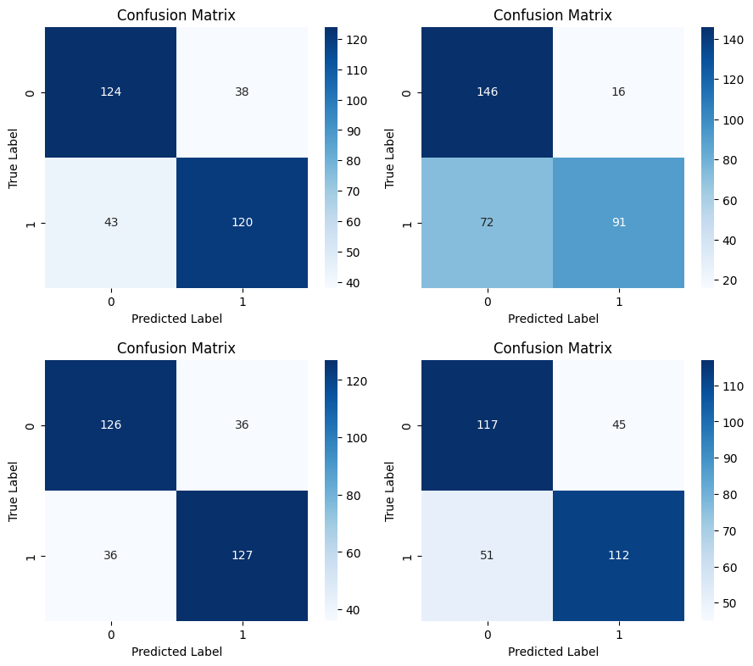
Confusion Matrix of Binary Models with the upper 2 being logistic regression in 128x64 and 64x32 respectively and the bottom 2 are of LDA respectively.
0:Alz
1:Not_Alz

Slide 13
MultiClass
Classification
Multi class LDA(PCA)
 | 64x32 | 128x64
Normal | 0.465437788 | 0.490015361
Blur | 0.4500768049 | 0.4792626728
Canny | 0.4700460829 | 0.4869431644
Naïve bayes
 | 64x32 | 128x64
Normal | 0.6651305684 | 0.6651305684
Blur | 0.6835637481 | 0.6912442396
Canny | 0.5975422427 | 0.5960061444
KNN
 | 64x32 | 128x64
Normal | 0.6205837174 | 0.6221198157
Blur | 0.6159754224 | 0.6205837174
Canny | 0.7603686636 | 0.7803379416

Slide 14
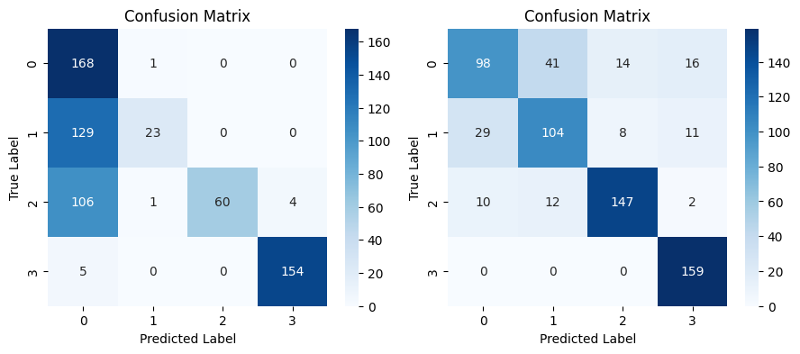
Comparison of Confusion Matrix (KNN)
0:Non,
1:VMild,
2:Mild,
3:Moderate
Normal Canny Edge

Slide 15
Comparison of Confusion Matrix (KNN)
Reason for Increased Accuracy:-
Edge Reducing Noise
Decreasing Similarity
Suitable for KNN

Slide 16
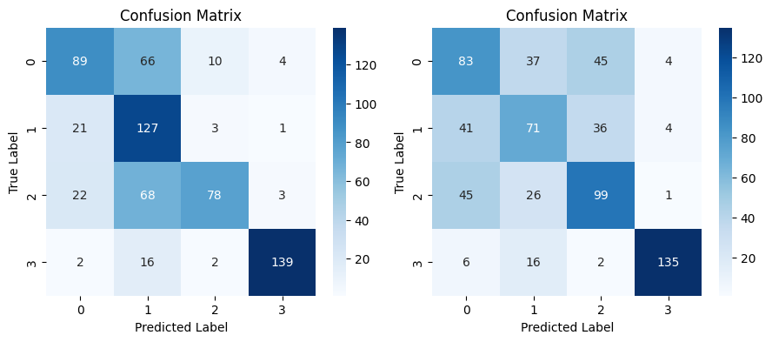
Comp’n of Confusion Matrix (Naive Bayes)
0:Non,
1:VMild,
2:Mild,
3:Moderate
Normal Canny Edge

Slide 17
Comp’n of Confusion Matrix (Naive Bayes)
Reason for Decreased Accuracy:-
Denial of Feature Independence.
Not so ideal for probabilistic models.

Slide 18
1 vs 1 Models
ONE vs ONE | LDA(PCA)
 |  | 64x32 | 128x64
 | Normal | 0.7561728395 | 0.774691358
 | Blur | 0.7361111111 | 0.7608024691
 | Canny | 0.6682098765 | 0.612654321
 | Log Regression
 |  | 64x32 | 128x64
 | Normal | 0.8194444444 | 0.8271604938
 | Blur | 0.8086419753 | 0.8179012346
 | Canny | 0.7299382716 | 0.774691358

Slide 19
Ensembling Results
For 64x32:
Ensemble Accuracy: 82.72%
Ensemble Precision: 83.57%
Ensemble Recall: 82.72%
Ensemble F1-score: 83.14%
For 128x64:
Ensemble Accuracy: 83.18%
Ensemble Precision: 83.77%
Ensemble Recall: 83.18%
Ensemble F1-score: 83.48%

Slide 20
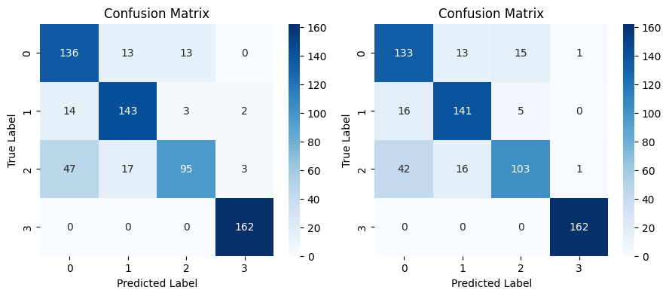
Confusion Matrix of Ensembles
0:Non,
1:VMild,
2:Mild,
3:Moderate
(64x32) (128x64)

Slide 21
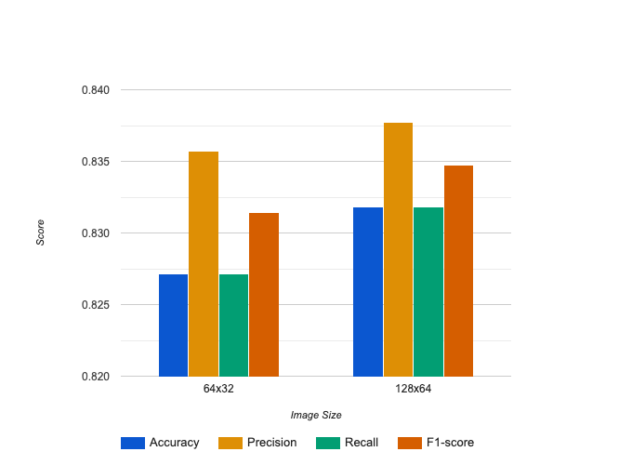
Ensembling Results

Slide 22
Conclusion
In 64x32 image size, KNN with Canny ( 76% ), 1vs1 LDA ( 75.6% ), and 1vs1 Logistic Regression (81.9%) Ensembled to 82.72%.
In 128x64 image size, KNN with Canny ( 74.5% ), 1vs1 LDA ( 77.5% ), and 1vs1 Logistic Regression (82.7%) Ensembled to 83.18%.
Increase in Accuracy in both image dimensions!!
Likely, Classifiers are accurate and have diverse errors.

Slide 23
Future Works
Data Merging and Augmentation
Using Image in Real Dimension (Computationally Heavy)
Auto-Encoders (Deep Learning)
Image Classification (Deep Learning-Tensorflow)

Slide 24
References
1. Challis, E., Hurley, P., Serra, L., Bozzali, M., Oliver, S., & Cercignani, M. (2015). Gaussian process classification of Alzheimer's disease and mild cognitive impairment from resting-state fMRI. NeuroImage, 112, 232-243.
2. Subramoniam, M., Aparna, T. R., Anurenjan, P. R., & Sreeni, K. G. (2022). Deep learning-based prediction of Alzheimer’s disease from magnetic resonance images. In Intelligent vision in healthcare (pp. 145-151). Singapore: Springer Nature Singapore.
3. Knox, S. A., Chen, T., Su, P., & Antoniou, G. (2021). A parallel machine learning framework for detecting Alzheimer’s disease. In Brain Informatics: 14th International Conference, BI 2021, Virtual Event, September 17–19, 2021, Proceedings 14 (pp. 423-432). Springer International Publishing.
4. Fulton, L. V., Dolezel, D., Harrop, J., Yan, Y., & Fulton, C. P. (2019). Classification of Alzheimer’s disease with and without imagery using gradient boosted machines and ResNet-50. Brain sciences, 9(9), 212.
5. Duarte, K. T., de Paiva, P. V., Martins, P. S., & Carvalho, M. A. (2019). Predicting the Early Stages of the Alzheimer's Disease via Combined Brain Multi-projections and Small Datasets. In VISIGRAPP (4: VISAPP) (pp. 553-560).
6. Marcus, D. S., Wang, T. H., Parker, J., Csernansky, J. G., Morris, J. C., & Buckner, R. L. (2007). Open Access Series of Imaging Studies (OASIS): cross-sectional MRI data in young, middle aged, nondemented, and demented older adults. Journal of cognitive neuroscience, 19(9), 1498-1507.

Slide 25
Thank You

